Slide 1
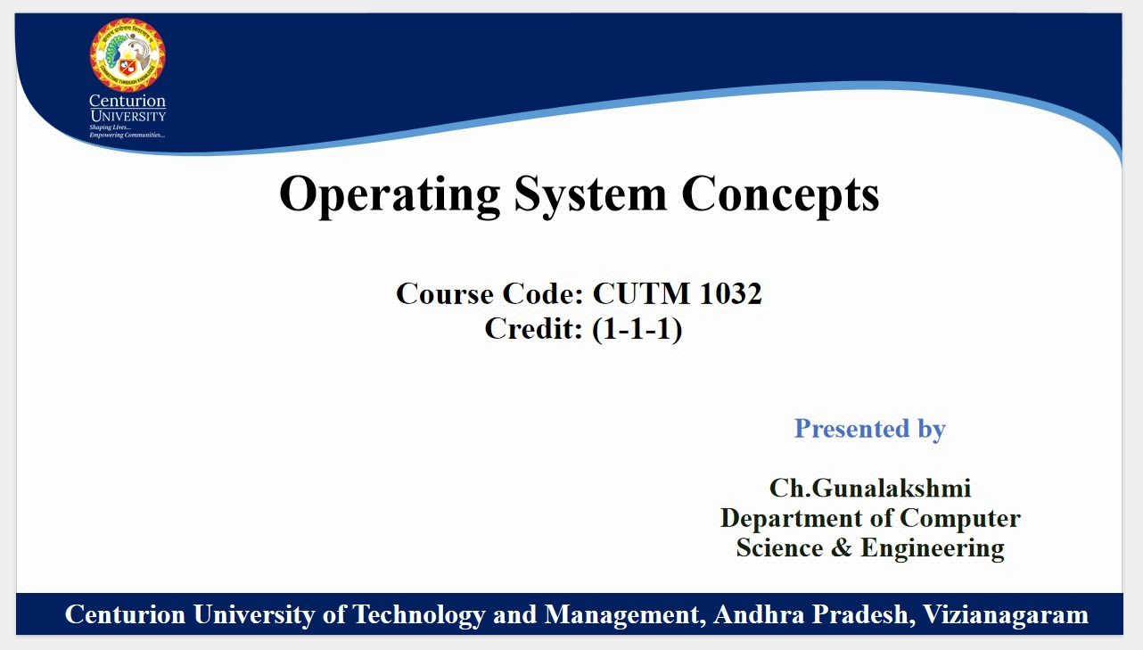
U HARIKA

Slide 2
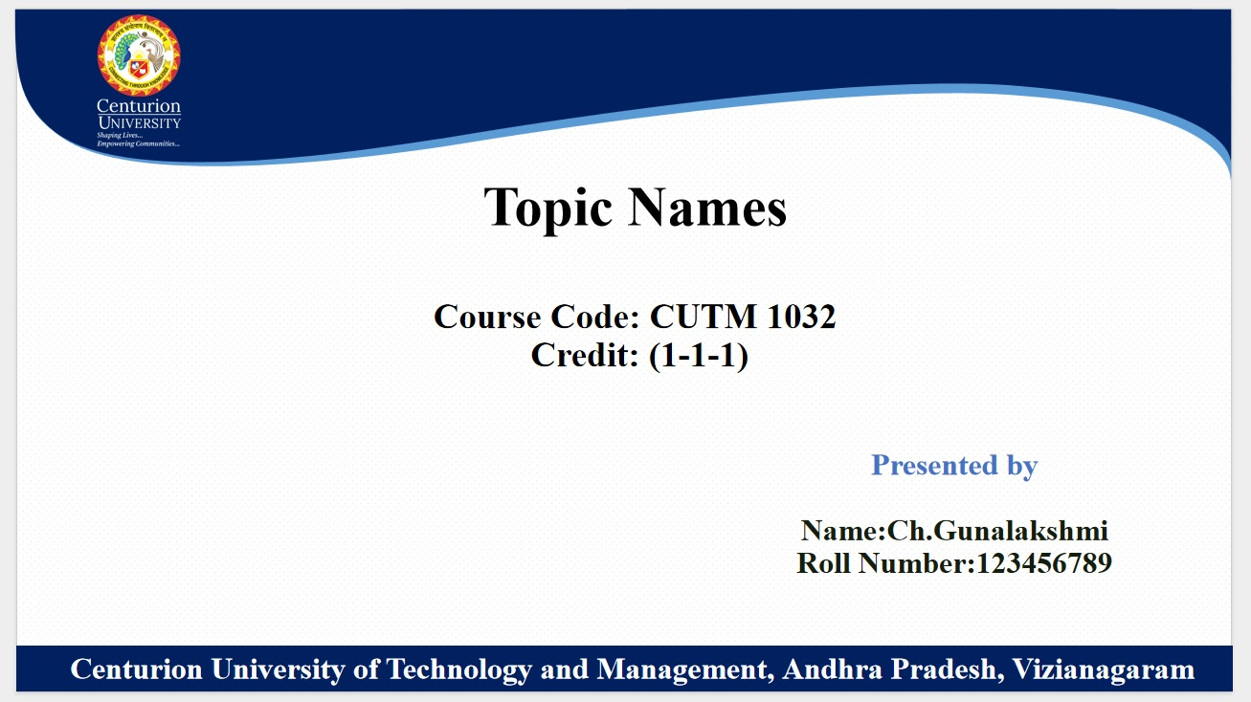
What is OS & Working with directories
Name: URJANA HARIKA
Roll Number: 221801120001

Slide 3
WHAT IS OS
An operating system is a collection of software that manages computer hardware resources and provides common services for computer programs.
It acts as an interface between users, software, and different parts of the computer hardware allowing users to interact with the computer and utilize its resources effectively.
The operating system performs tasks such as managing memory, handling input and output devices, scheduling tasks, and providing a user interface.

Slide 4
FUNCTIONS OF AN OPERATING SYSTEMS
Hardware Management: Manages computer hardware resources such as CPU, memory, storage devices, and input/output devices.
Process Management: Handles the execution of processes, scheduling tasks, and allocating system resources to running programs.
Memory Management: Controls and optimizes the use of computer memory to ensure efficient operation and prevent conflicts.
File System Management: Organizes and controls the storage and retrieval of data on storage devices.
User Interface: Provides a user-friendly interface for users to interact with the computer, including graphical user interfaces (GUIs) and command-line interfaces (CLIs).

Slide 5
IMPORTANCE OF OPERATING SYSTEMS
Resource Management: Efficiently manages hardware resources, optimizing performance and ensuring stability.
Application Support: Provides a platform for software applications to run and interact with hardware.
User Experience: Offers a seamless and intuitive interface for users to interact with the computer and its applications.
Security: Implements security measures to protect against unauthorized access and malicious software.
Compatibility: Ensures compatibility with various hardware configurations and software applications.

Slide 6
Working with directories :
Directories are specialized files that act as containers for organizing files and other directories. They provide a structured way to store and access data on a computer system. Directories are hierarchical, meaning they can contain other directories, forming a tree-like structure.
The following commands shows how to work with directories :
1.Pwd (Print Working Directory):
Display the full path-name for the current directory.
EXAMPLE:
- pwd

Slide 7
2. cd (change Directory):
Allows you to change your current directory (working directory).
You can use absolute or relative paths.
EXAMPLE:
1 To create a directory
- mkdir _dirname
2 To open a directory
- cd _dirname
3 To go back to home Directory
- cd ~
4 To remove a directory permanently
- rmdir _dirname

Slide 8
THANK YOU

